Slide 1
INFO3111: C++ 3D Graphics
Lasciate ogne speranza, voi ch'entrate
With You Hosts: Michael Feeney and Matthew Douglas

Slide 2
Course Flow
May-June (week 1-7: Michael Feeney
July-Aug (week 8-14): Matt Douglas

Slide 3
What’s this course about?
See the CIS (or whatever that’s called now) on FOL
Intro to (soft) “real time” 3D graphics using a C/C++ API. Popular ones:
DirectX (aka Direct 3D), OpenGL, OpenGL ES, Vulkan
The “C/C++” part come into play with:
OpenGL is a mature “C” API (as most “C++” APIs are)
The API is just to controlling the GPU, the C++ supports everything else
How do we manage/maintain/extend this little “framework” we have?
A comparison might be a database API, where we have all this other code that uses that API to do something useful.

Slide 4
What’s this course about?
Graphics API: we’ll be using OpenGL 4.6 (+glad, GLFW, and glm)
We’ll also need some other glue code:
glad: https://glad.dav1d.de/
GLFW: https://www.glfw.org/
glm: https://glm.g-truc.net/0.9.9/
I may show you some Vulkan, too, but we’ll see how it goes…

Slide 5

3D!! OpenGL!!! C++!!! SWEET, dude!
Let’s write Halo 17! Today!! RIGHT NOW!!!
Hold on, buckaroo…
It’s an introduction
You need to walk before running
Some of this stuff is pretty difficult
There’s some math in here
And a lot of it isn’t intuitive at all…
What CPAs find “challenging” tends to be a little unexpected (more in a moment)

Slide 6
What do you need?
Your brain
Visual Studio 2022 or 2026
Community Edition is fine (C++ compiler is identical will all versions)
GitHub and Git for Windows
Code link: https://github.com/FeeneyCodes/INFO-3111--02--26S
After this week, everything will be on github
GLFW, glad, and glm
Notepad++ (likely)
MeshLab (helpful)

Slide 7
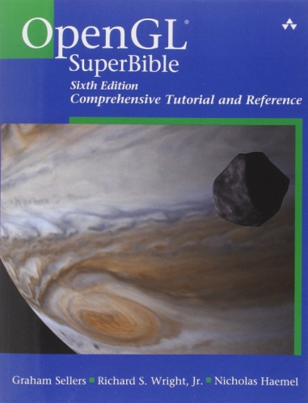

Some suggested books (OpenGL)
OpenGL SuperBible: Comprehensive Tutorial and Reference by Graham Sellers (OpenGL driver team for AMD) et al
OMG! That’s, like, THE TEXTBOOK!!!
#mindblown
Notes:
http://advancedesl.files.wordpress.com/2011/01/15.jpg

Slide 8

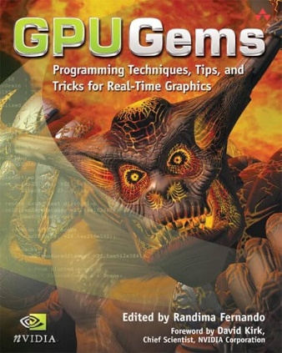
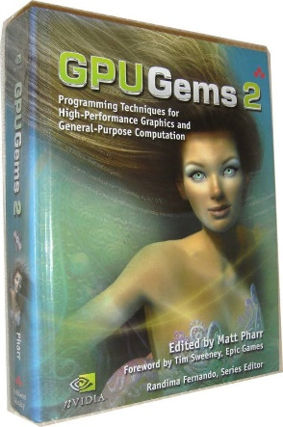
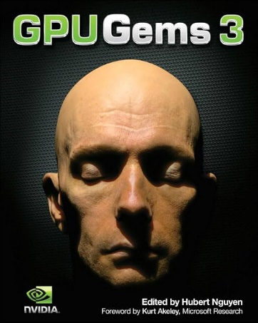
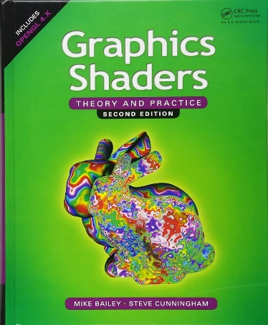
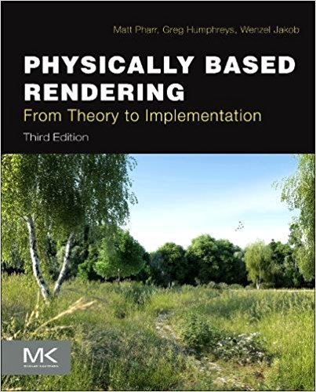
These are good books, too…
They are NOT needed in this course!
And if you are really into graphics
This book won an Academy Award. True Story: https://www.youtube.com/watch?v=7d9juPsv1QU
Notes:
http://advancedesl.files.wordpress.com/2011/01/15.jpg

Slide 9
Two sections:
There are two sections in this class
One is face-to-face, in person
One is online asynchronous

Slide 10
What you should know (or will know, soon)
Some C++, and how C++ projects build
compile vs. link, #include issues, file scope, etc.
Some STL (vector, string, map, etc.)
Some basic algorithm stuff, maybe
Including the basics of the STL algorithm
Note: my def. of algorithm might be very, very different from yours… heads up
Some debugging skills
How to pay attention
How to keep “plugging along” (Coolidge)
Don’t know some (all?) of that?
Well, that’s why you’re in school, right?

Slide 11

What you want to know...
You
What you already know
Valley of confusion, lack of knowledge and skill, and frustration...
Notes:
http://hinglecoaching.com/images/mission%20man2.jpg

Slide 12
But I’m, like, SUPER IMPATIENT, man!!!
Why can’t we do something, like, TODAY!?
I mean, we could use, like, a GAME ENGINE!
Or Flash? HTML 5.0? Or Unity?? Why not that? It’s so “easy”!
Come ON!!!
...Let me give you two analogies...

Slide 13
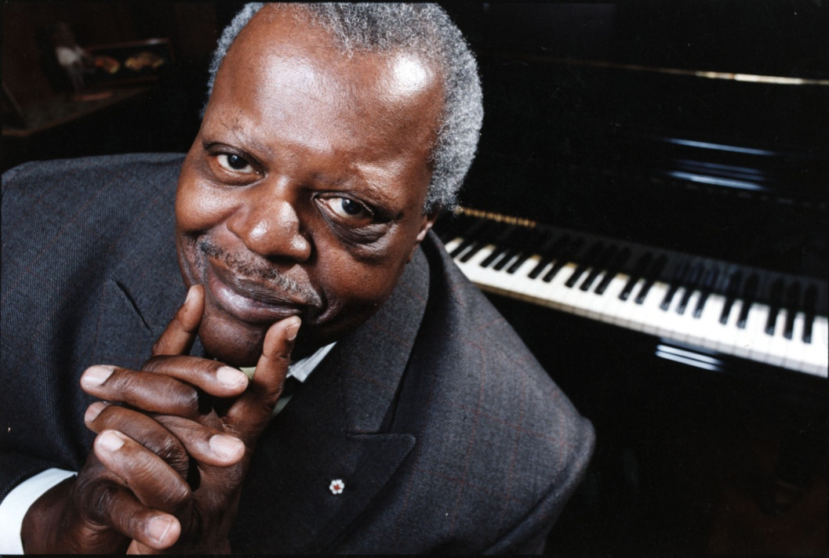

This is Glenn Gould & Oscar Peterson
They were two of the greatest piano players in history
If you wanted to play like these guys, how would you go about it?
Notes:
http://www.thestar.com/content/dam/thestar/entertainment/music/2013/11/07/oscar_peterson_award_to_be_handed_out_at_york_u_gala/oscar_peterson.jpg
http://www.parkinggaragepolitics.com/wp-content/uploads/2013/03/Glenn-Gould-Source-Unknown.jpg

Slide 14


Or how about Bobby Orr or Wayne Gretzky?
Again, if you wanted to play like these guys, how would you go about it?
Notes:
http://i.cdn.turner.com/si/multimedia/photo_gallery/1004/revolutionary.moments.in.sports/images/wayne-gretzky.jpg
http://www.bobbyorrcollector.com/wp-content/uploads/2011/11/img165-784x1024.jpg

Slide 15
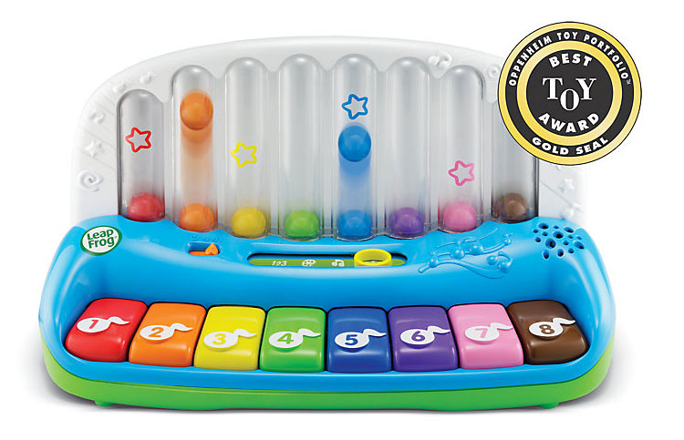

Simple, but no simpler…
Well, we could start with something like this...
But eventually, we’d have to use the real thing.
Notes:
http://images.amazon.com/images/G/01/toys/detail-page/c26-B00804BDE0-1-l.jpg
https://img1.etsystatic.com/000/0/6308893/il_fullxfull.305981903.jpg

Slide 16
Commercial graphics APIs… (DirectX, OpenGL, Vulkan, Metal, etc.)
Are very mature
Aren’t intended to be “for beginners”
There’s a lot of things that can “go wrong”
There’s a lot of things you have to know before you can be even remotely productive
(Just like playing an instrument...
...or being ½ way useful at a sport, right?)
You’re going to screw up/fall down... a lot.
They are very low level (are “C”, NOT “C++” APIs)

Slide 17
What’s this course not about (1/3)?
Ray-tracing.
Old OpenGL (fixed function pipeline)
Pre OpenGL 2.0 (glVertex(), etc.)
DirectX: (there are a lot of similarities with OpenGL)
GDI, GDI+, Flash, HTML 5, WebGL, or any other graphics APIs
Especially, it’s not Unity (or godot) or whatever.
It’s so not that.

Slide 18
What’s this course not about (3/3)?
“Stupid” unnecessary programming/C++ stuff:
Pointless (aka. unnecessary) templates
Pointless (unnecessary) classes/inheritance
Any combination of the words “best” and “algorithm”
Anything the committee added “because it’s cool” or “modern”
Look into how the C++ committee is run…
It’s not a real reflection of what the programmers are doing/wanting
The “best” way to do something.
This like arguing what’s “the best piece of LEGO” and missing the point that you’re supposed to me MAKING something with the LEGO…

Slide 19
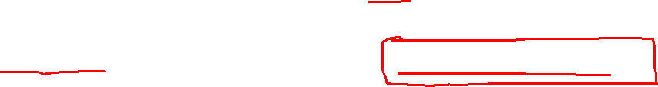
Whatever is really in use, currently
It’ll be focused on C/C++ stuff that’s actually used.
It won’t be a “all the new stuff in the library”
Will lean towards more “system” stuff because:
C APIs tend to be more low level
Why use a “system language” (like C & C++) if you don’t look at that.
“Modern C++” tend to hide this stuff
John Blow says “Moden C++” means “I’m afraid of pointers”

Slide 20
Other things
No boost and other 3rd party libraries.
If you use boost in your exams or projects, they will not be marked. Find another way.
boost is *written in* C++, but boost != C++
“auto” keyboard. Just no.
I reserve the right to give you zero if you use auto.
Yes, I’m very aware of what it does, etc.
Any other library: ask me first, but likely “no”
Just do it the way I asked because I ask you to.
Like arrays, etc.

Slide 21
chatGPT, etc. : Here’s The Deal
I’m expecting you to know how to do this.
This doesn’t mean “just getting an answer”
If I suspect that you don’t know the code you submitted (either you copied it, chatGPT’d it, got it from another site…) then I will ask you about it, one on one, face to face (or zoom)
At that point, you need to prove to me that you actually know what the heck you are talking about.
It’s a “guilty until proven innocent” situation.
If you are clueless, then you cheated.

Slide 22
How you pass

Slide 23
Your marks…
“Project” mark: 40%
10-12 checkpoints worth 10% TOTAL
(Lowest 2 marks will be dropped, so you can miss 2)
2 projects worth 15% each
Projects are due right before the exam, and are intended to help you prepare for the exam
“Exam” mark: 60%
Midterm and final (each 30%)
You have to pass the exam portion to pass the course
50% is a “pass” in this AND EVERY OTHER course.

Slide 24
Checkpoints: 10%
Assigned at the end of class
Due at the start of the next class
There are no extensions or late marks, since I’ll be giving you the solutions.
You should do them yourself.
There are no late marks (since I will be giving a solution at the next class.)
There might be a “bonus” checkpoint at the end, worth 2%, added directly to your mark (up to the 40% of the “projects” portion)
The students who do their own checkpoints tend to do better on the exams. Really?! Who would have thought?

Slide 25
2 Projects: 15% each
Due right before the exams.
Unless there are “exceptional circumstances” (Policy A-131), if you miss the deadline, you get zero (that is the policy, by the way)
You should do them yourself.
There are no late marks
Unless there are “exceptional circumstances” (Policy A-131)
If you miss the deadline, you get zero (that is the policy, by the way)
Projects are intended to help you with the exam. i.e. if you did well on your project (delivered what I ask for) then you should pass the exam.

Slide 26
2 Exams: 30% each
2 of them: mid-term (around day 7/8) & final (day 14/“exam week”)
“3 hours” in that you can complete it in 3 hours.
Face to face, in person students: you’ll write exams in class, in a 3-hour time block at the usual class time.
Asynchronous students: will have a different exam that you have a time window to complete and submit.
There’s no “late submission” window for exams.

Slide 27
“Part marks”
Students seem to love “part marks.”
Now, I’ll try really hard to be fair, but:
Have you ever had a plumber “almost” fix your toilet?
Did you pay them?
Ever “sort of” broke your leg?
Get a cast for that?
Ever “almost” paid your mortgage?
How did the bank like that?
Did you buddy “almost” pay you that $50 they owe?
Did you call that square?
Would you loan them money again?
If your code won’t build, then I can’t mark it. Period.
You can’t “almost” meet a checkpoint.

Slide 28
Data
Code
Data

Slide 29

Good news, everyone!
We’re going to code now!

Slide 30
And now…
…enough goofing around…
Ladies and Gentlemen, start your Browser and Visual Studio.
We’re going to get some OpenGL code, get it running, and go from there.
While we are doing that, I’ll start explaining “what is OpenGL”

